Slide 1
Piedmont University Walker College of Business 2021-2022 SACS MBA Report
Attachment 1 | Assessment Value Chain
Attachment 2 | Causal Model
Attachment 3 | Goal 1, Measure 1 – Peregrine: All Categories (PLO 1-11)
Attachment 4 | Goal 1, Measure 1 – Peregrine: Marketing (PLO 1)
Attachment 5 | Goal 1, Measure 1 – Peregrine: Finance (PLO 2)
Attachment 6 | Goal 1, Measure 1 – Peregrine: Accounting (PLO 3)
Attachment 7 | Goal 1, Measure 1 – Peregrine: Management (PLO 4)
Attachment 8 | Goal 1, Measure 1 – Peregrine: Business Law (PLO 5)
Attachment 9 | Goal 1, Measure 1 – Peregrine: Economics (PLO 6)
Attachment 10 | Goal 1, Measure 1 – Peregrine: Ethics (PLO 7)
Attachment 11 | Goal 1, Measure 1 – Peregrine: Global Issues (PLO 8)
Attachment 12 | Goal 1, Measure 1 – Peregrine: Information Systems (PLO 9)
Attachment 13 | Goal 1, Measure 1 – Peregrine: QM & Statistics (PLO 10)
Attachment 14 | Goal 1, Measure 1 – Peregrine: Strategy (PLO 11)
Attachment 15 | Goal 1, Measure 2 – Student Satisfaction with Learning (PLO 12)
Attachment 16 | Goal 2 – Integration of Critical Thinking
Attachment 17 | Goal 3 – Effective Research: Business Problems
Attachment 18 | Goal 5 – Integration of Strategy
Attachment 19 | Assessment Survey Instrument – Walker College of Business

Slide 2
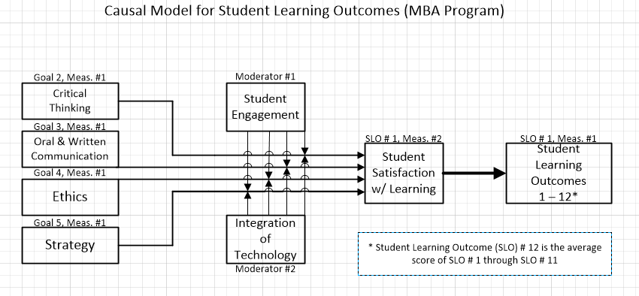
2021-2022 MBA Report Attachment 1
Assessment Value Chain
Inputs (Activities)
Outputs
Outcomes (measured)
Impacts
Curriculum design Faculty credentials ACBSP Figure 6.5 CPC Plan | Courses taught (contact hours) DQ-PQ results Goal integration into Table 7 plan | Assessed goals Student satisfaction Student engagement | Goal # 1 Student Learning Outcomes 1 thru 12 10 Year Alumni Survey on Curriculum
Attachment 1 depicts the causal model showing
the relationship between causal variables,
moderator variables, and the outcome variable –
student satisfaction with learning (SSL).
By adjusting (through the use of action plans) the
causal and moderating variables we produce the
outcome variable – SSL which in turn produces
the desired impact – increased scores on the
external Peregrine test.
.801*
* Pearson Bivariate
Correlation
Causal Factors
Moderators
Outcome (SSL)
Impact (SLO)

Slide 3
2021-2022 MBA Report Attachment 2
AY 2021-2022 MBA Program
ACBSP CPC Program Planned Contact Hours
Direct and Integrated Topic Hours are Broken Out
The ACBSP standard syllabi containing the base data for each course shown above as noted in review date is scheduled for a complete redevelopment by the faculty during August 2017. A completely new roll up is only performed every three years. This update is more important than usual because we have added Data Science to the Undergraduate Business Program and this will change many of the courses.
Course credit hours and program length both meet or exceed institution requirements for credit hours per course and credit hours per degree.
Piedmont University Faculty and Academic Policies and Procedures, Section 4.1.A

Slide 4
2021-2022 MBA Report

Slide 5
2021-2022 MBA Report

Slide 6
2021-2022 MBA Report

Slide 7
2021-2022 MBA Report

Slide 8
2021-2022 MBA Report

Slide 9
2021-2022 MBA Report

Slide 10
2021-2022 MBA Report

Slide 11
2021-2022 MBA Report

Slide 12
2021-2022 MBA Report

Slide 13
2021-2022 MBA Report Attachment 19

