Slide 1
Piedmont University
Walker College of
Business
2021-2022
SACS
UG Report
Attachment 1 | Assessment Value Chain
Attachment 2 | Goal 1, Measure 1 – Peregrine: All Categories (PLO 1-11)
Attachment 3 | Goal 1, Measure 1 – Peregrine: Marketing (PLO 1)
Attachment 4 | Goal 1, Measure 1 – Peregrine: Finance (PLO 2)
Attachment 5 | Goal 1, Measure 1 – Peregrine: Accounting (PLO 3)
Attachment 6 | Goal 1, Measure 1 – Peregrine: Management (PLO 4)
Attachment 7 | Goal 1, Measure 1 – Peregrine: Business Law (PLO 5)
Attachment 8 | Goal 1, Measure 1 – Peregrine: Economics (PLO 6)
Attachment 9 | Goal 1. Measure 1 – Peregrine: Ethics (PLO 7)
Attachment 10 | Goal 1, Measure 1 – Peregrine: Global Issues (PLO 8)
Attachment 11 | Goal 1, Measure 1 – Peregrine: Information Systems (PLO 9)
Attachment 12 | Goal 1, Measure 1 – Peregrine: QM & Statistics (PLO 10)
Attachment 13 | Goal 1, Measure 1 – Peregrine: Strategy (PLO 11)
Attachment 14 | Goal 1, Measure 1 – Peregrine: 5 Year Average by Campus
Attachment 15 | Goal 1, Measure 2 – GLO-BUS: Marketing (PLO 1)
Attachment 16 | Goal 1, Measure 2 – GLO-BUS: Finance (PLO 2)
Attachment 17 | Goal 1, Measure 2 – GLO-BUS: Accounting (PLO 3)
Attachment 18 | Goal 1, Measure 2 – GLO-BUS: Management (PLO 4)
Attachment 19 | Goal 1, Measure 2 – GLO-BUS: All Categories (PLO 1-4)
Attachment 20 | Goal 2 – Measure 1 and Measure 2 Critical Thinking
Attachment 21 | Goal 3 – Measure 1 and Measure 2 AY 20-21 Research
Attachment 22 | Goal 4 – Measure 1 and Measure 2 AY 20-21 Engaged Attitude
Attachment 23 | Assessment Survey Instrument – Walker College of Business

Slide 2
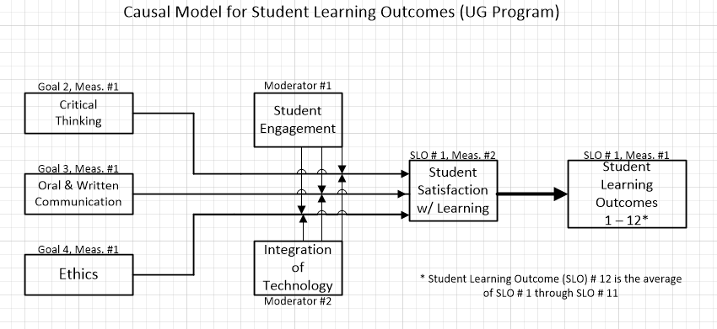
Assessment Value Chain
2021-2022 SACS UG Report
Attachment 1
Inputs
(Activities)
Outputs
Outcomes
(measured)
Impacts
Curriculum design Faculty credentials ACBSP Figure 6.5 CPC Plan | Courses taught (contact hours) DQ-PQ results Goal integration into Table 7 plan | Assessed goals Student satisfaction Student engagement | Goal # 1 Program Learning Outcomes 1 thru 12 Alumni Survey Impact Analysis (every 4 years)
.801*
* Pearson
Bivariate
Correlation
Causal
Factors
Moderators
Outcome
(SSL)
Impact
(PLO)

Slide 3
2021-2022 UG Report

Slide 4
2021-2022 UG Report

Slide 5
2021-2022 UG Report

Slide 6
2021-2022 UG Report

Slide 7
2021-2022 UG Report

Slide 8
2021-2022 UG Report

Slide 9
2021-2022 UG Report

Slide 10
2021-2022 UG Report

Slide 11
2021-2022 UG Report

Slide 12
2021-2022 UG Report

Slide 13
2021-2022 UG Report

Slide 14
2021-2022 UG Report

Slide 15
2021-2022 UG Report

Slide 16
2021-2022 UG Report
Attachment 23

